Slide 1
Capstone project
University success analysis

Slide 2
publication
In the Country Analysis Dashboard, we have deep insights on data that shows distribution of universities ,International students ,Total female students, male students also their percentage of distribution across the different country.
Country Analysis
The Student Analysis dashboard shows the insights on data that show how many students across the country are there in the university also they join on the basis of college score.
Student Analysis

Slide 3
In the Ranking Analysis dashboard Each University across the country has Categorised on the basis of ranking system it also allow the students to choose the college on the basis of ranking or which college has good teaching staff ,research ,highest placements ,student - ratio or Graduate rates.
Ranking Analysis
The University Analysis dashboard provides a detailed analysis of universities focusing on key metrics such as percentage of international students across the country, students-ratio, variation on number of students by year and which country has the highest score or best for students.
University Analysis

Slide 4



OBJECTIVE : The objective of this project is to leverage Power BI to analyze and visualize key metrics related to university success, including academic performance, global rankings, student enrollment trends, faculty strength, research output, and graduate employability. By integrating data from multiple sources, the project aims to provide interactive and insightful dashboards that help students, educators, and policymakers make data-driven decisions regarding university selection, investment in education, and institutional improvements.
ANALYSIS SCOPE : The analysis scope of this project includes evaluating university performance based on key factors such as global rankings (QS, THE, ARWU), student demographics, enrollment trends, faculty-to-student ratios, research output, graduate employability rates, tuition fees, and country-wise education policies. Using Power BI, the project will integrate, clean, and visualize data from multiple sources to create interactive dashboards that provide insights into university strengths, areas for improvement, and global education trends, enabling data-driven decision-making for students, educators, and policymakers.
GOAL : The goal of this project is to develop an interactive and data-driven Power BI dashboard that provides a comprehensive analysis of university success factors, enabling stakeholders—such as students, educators, policymakers, and researchers—to make informed decisions. By visualizing key metrics like global rankings, student demographics, faculty quality, research output, graduate employability, and financial considerations, the project aims to identify trends, compare institutions across different countries, and highlight areas for improvement, ultimately enhancing transparency and decision-making in higher education.

Slide 5



INSIGHT & RECOMMENDATION : The Power BI analysis will provide insights into university performance, highlighting key factors like faculty quality, research output, and employability, while offering data-driven recommendations to enhance academic excellence, student outcomes, and institutional growth.
REPORT & PRESENTATION : The report and presentation will showcase key findings from the Power BI analysis, including university performance trends, ranking insights, and student outcomes, using interactive visualizations to support data-driven recommendations for stakeholders.
POWER BI DASHBOARD : The Power BI dashboard will provide interactive visualizations of university rankings, student demographics, research output, faculty quality, and employability metrics, enabling users to explore insights and make data-driven decisions.

Slide 6
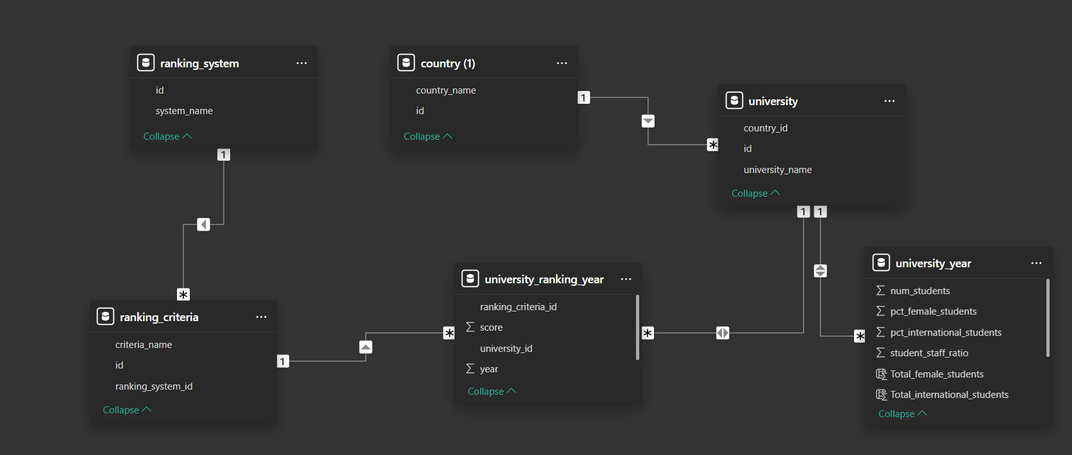
Er diagram

Slide 7
Power bi problem statement

Slide 8
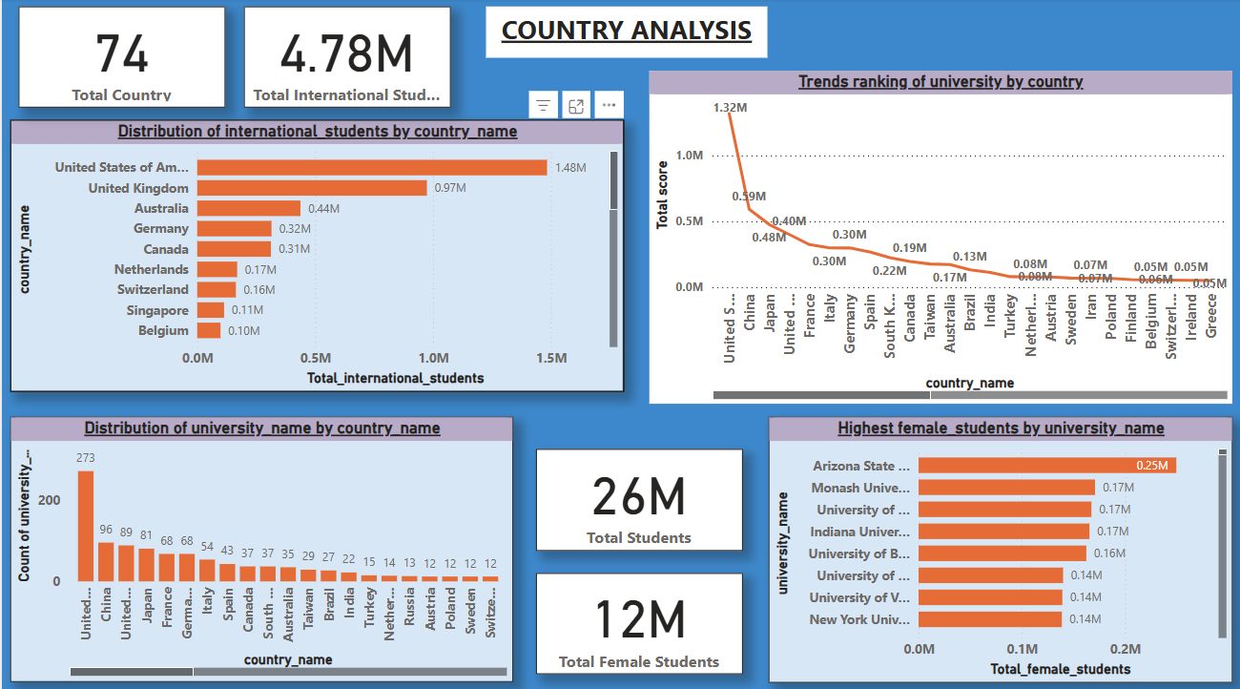

Slide 9
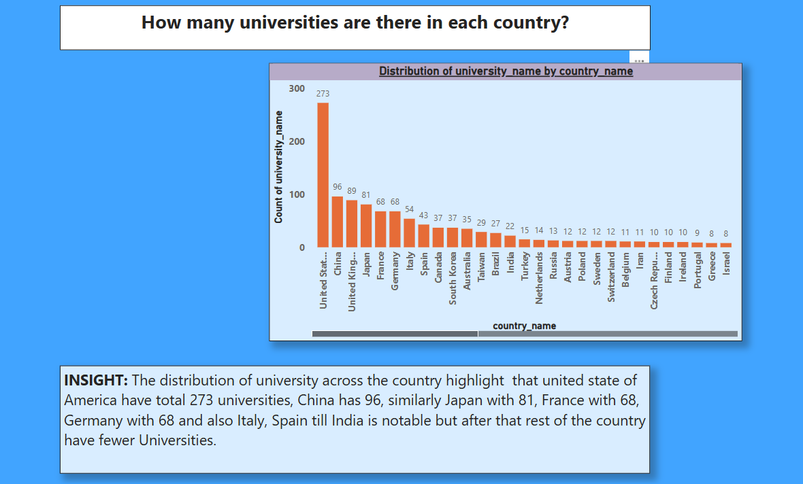

Slide 10
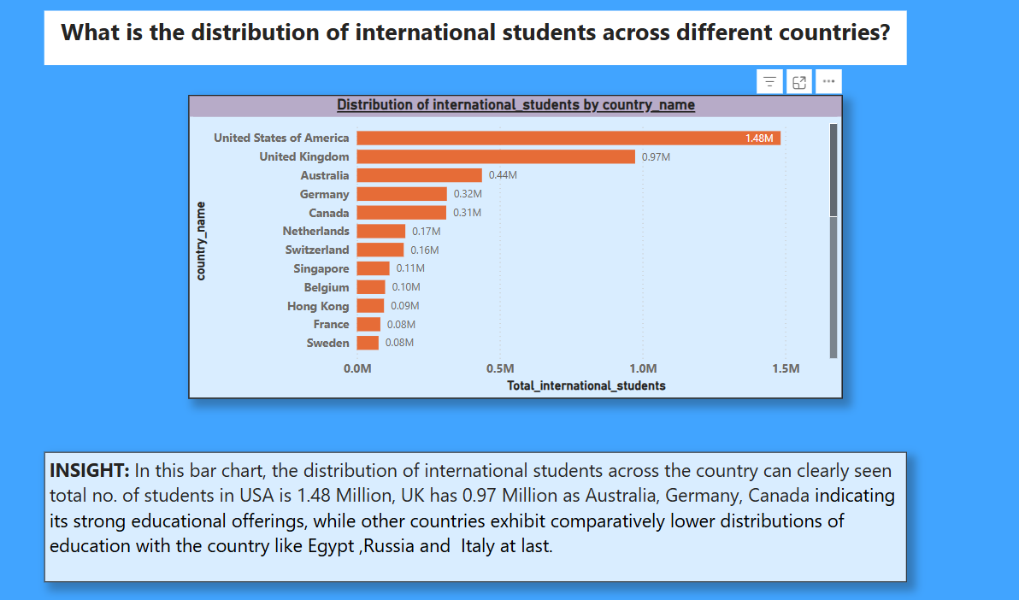

Slide 11
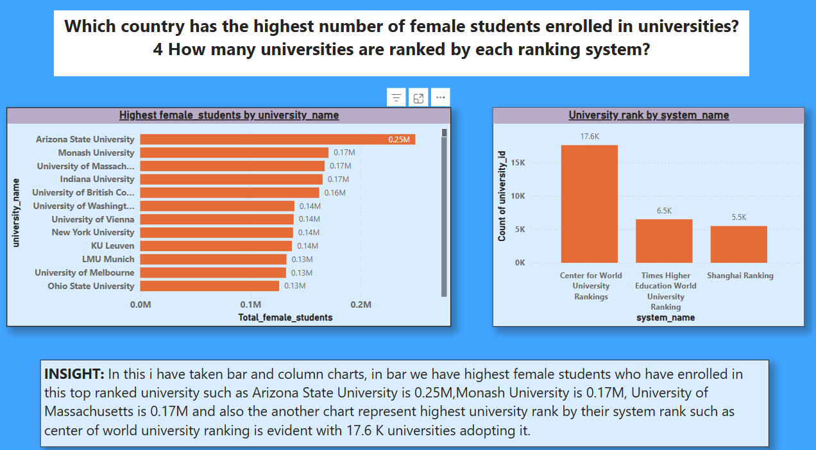

Slide 12
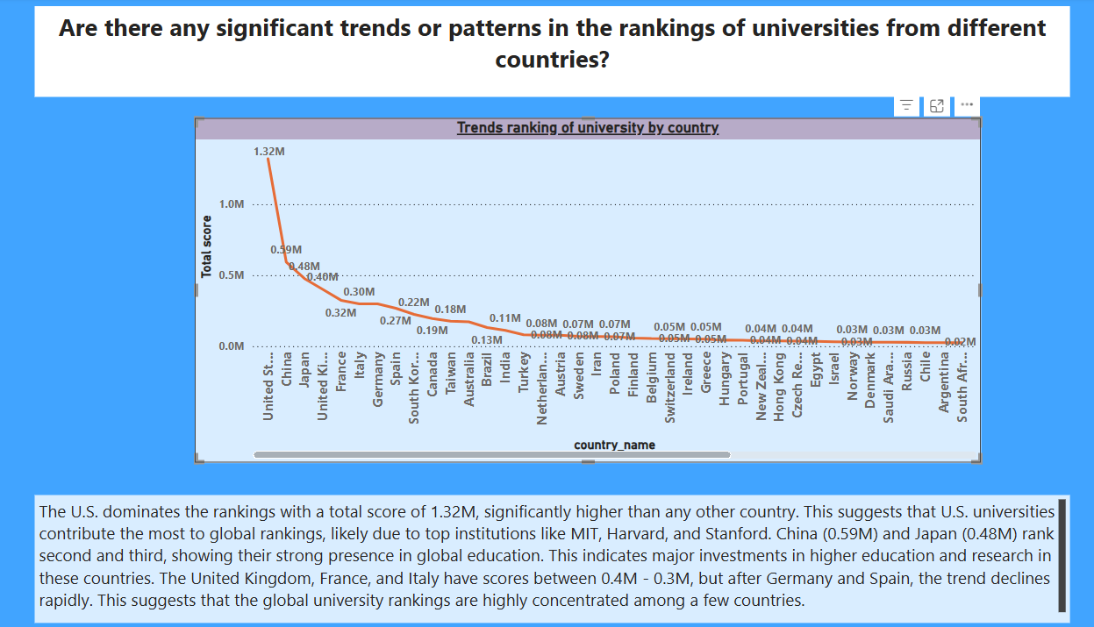

Slide 13
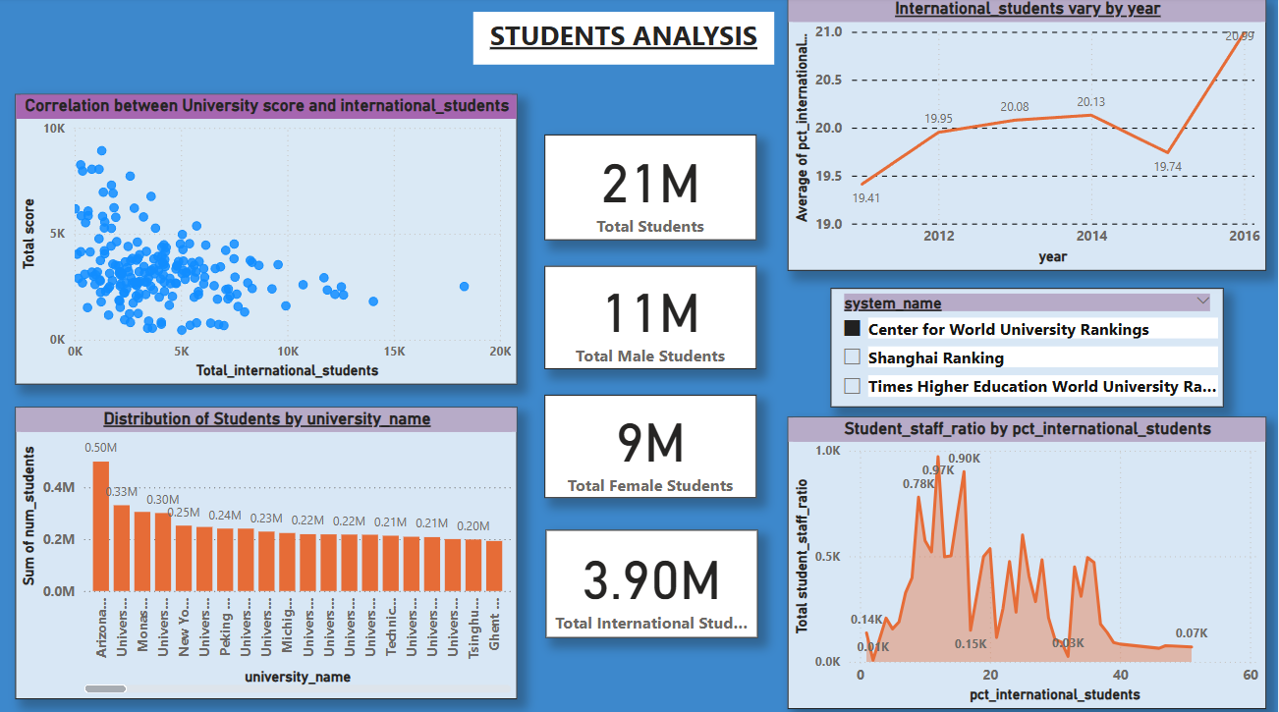

Slide 14
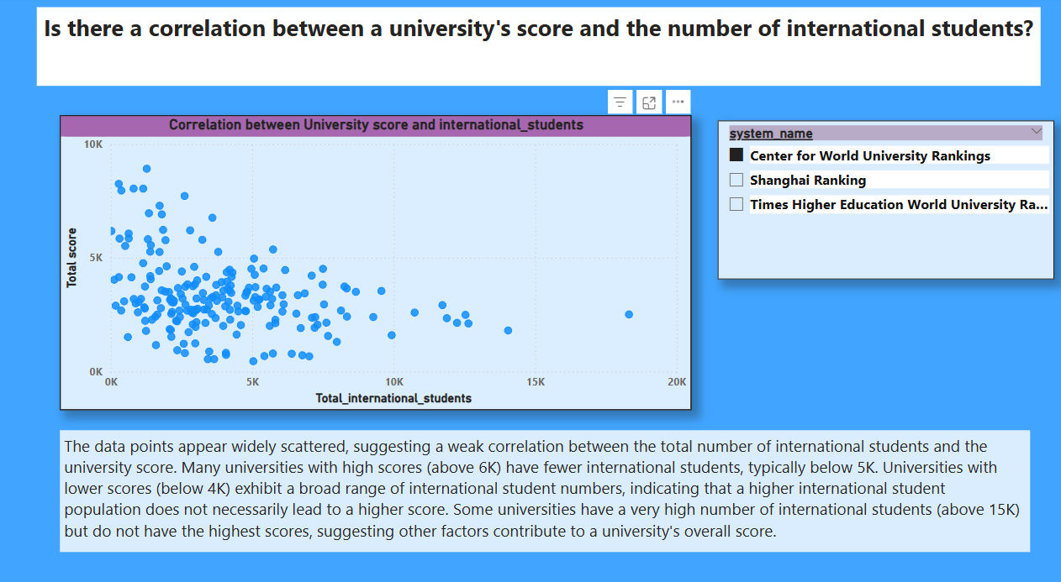

Slide 15
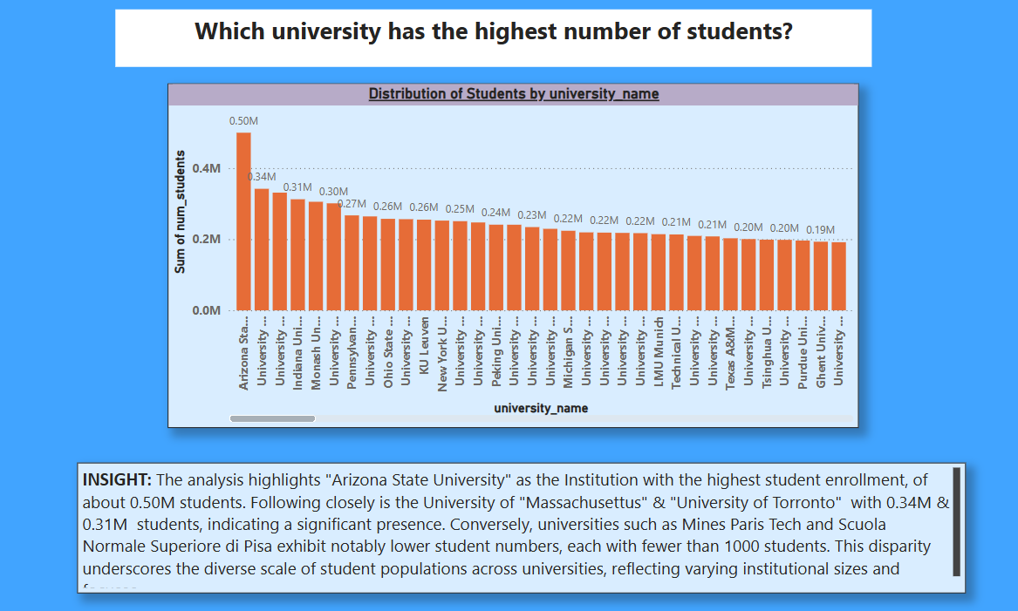

Slide 16
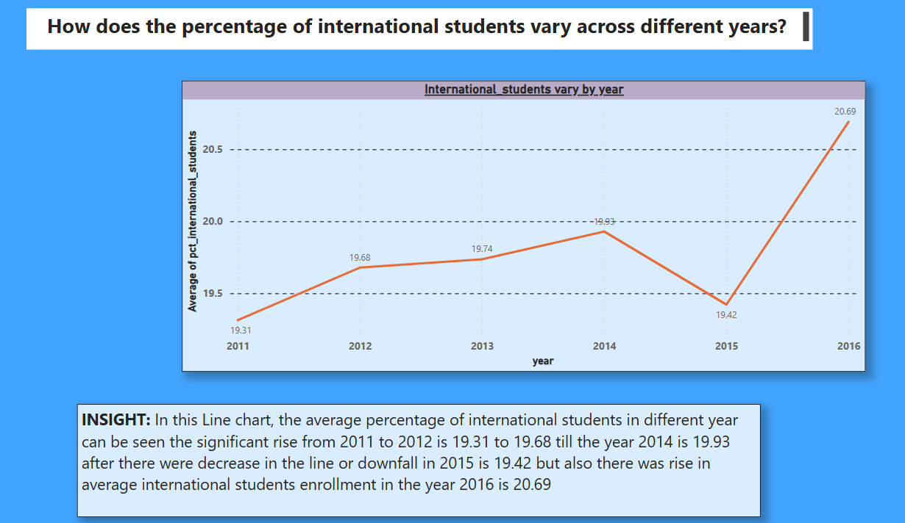

Slide 17
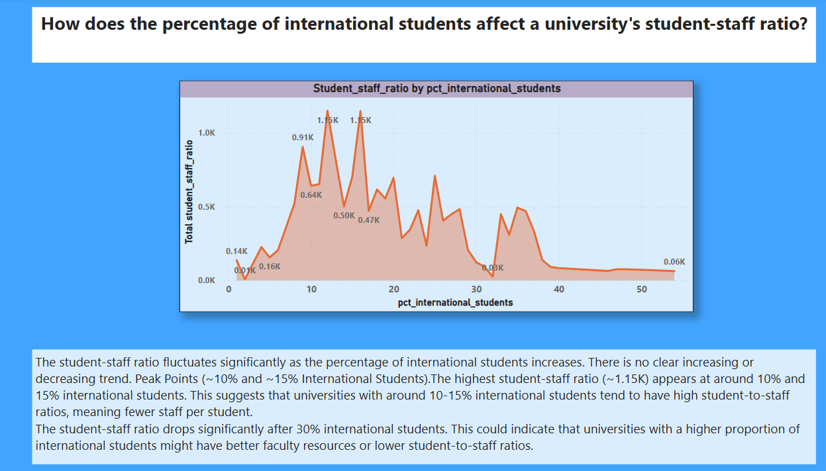

Slide 18
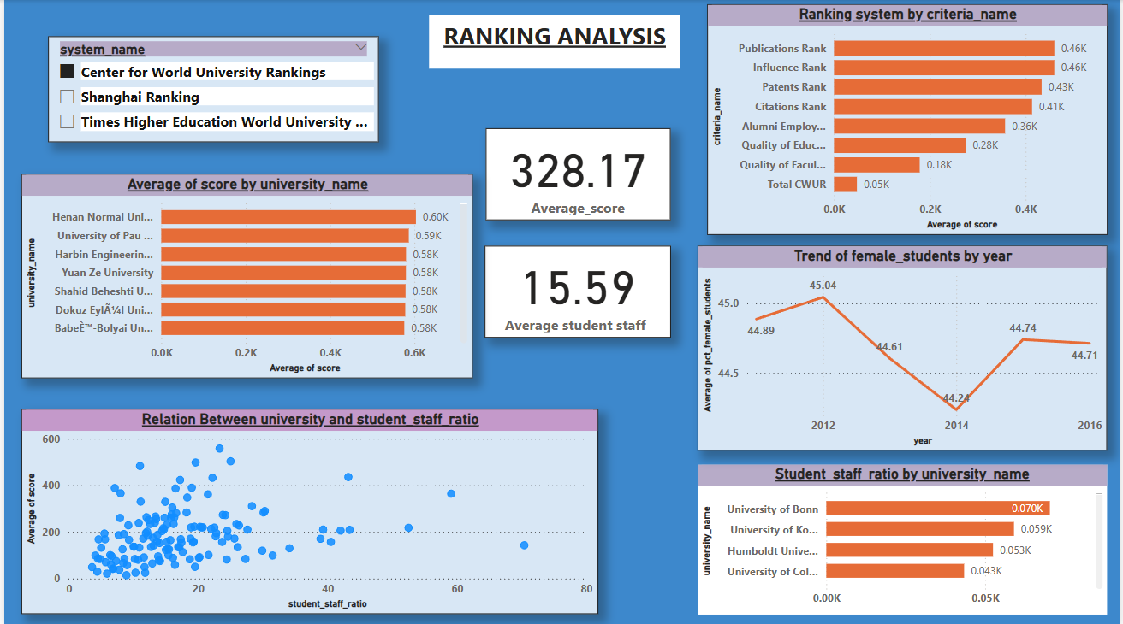

Slide 19
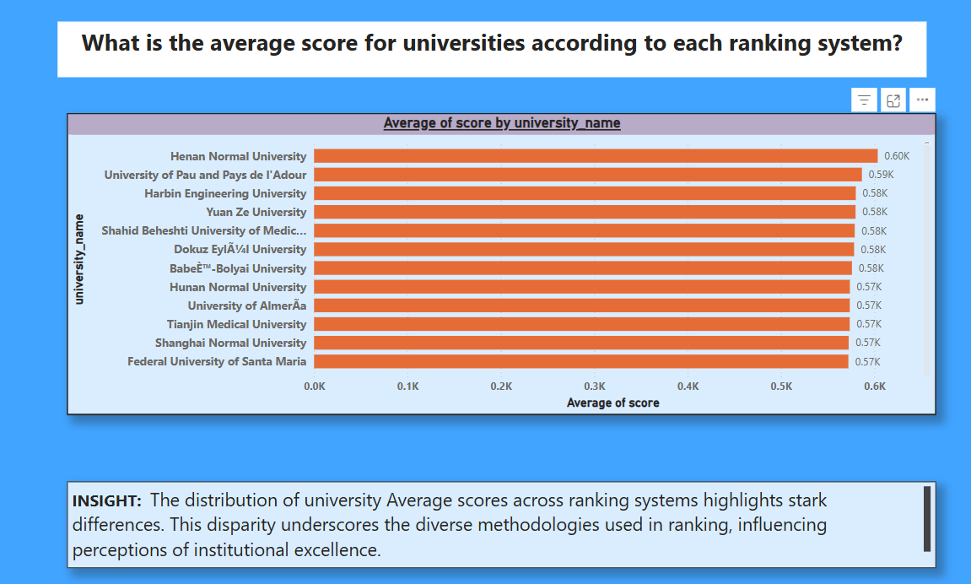

Slide 20
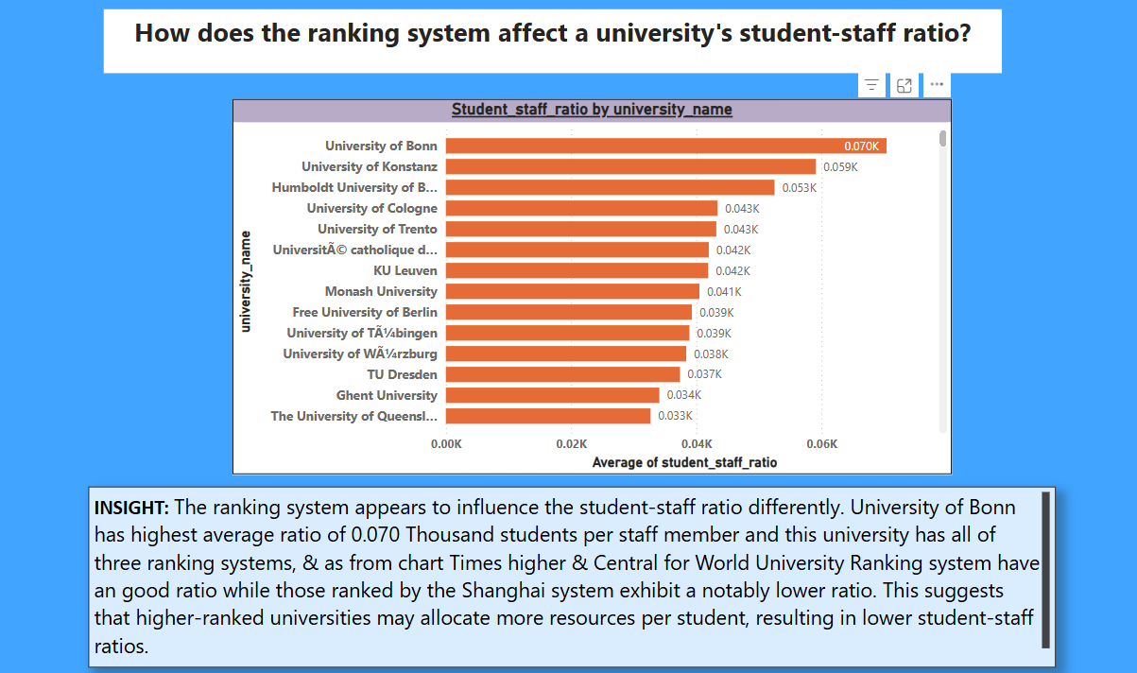

Slide 21
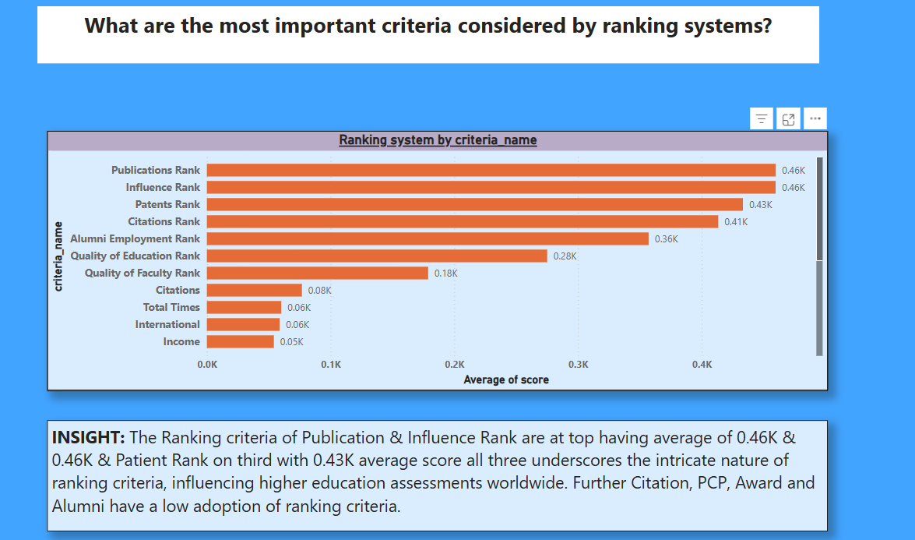

Slide 22
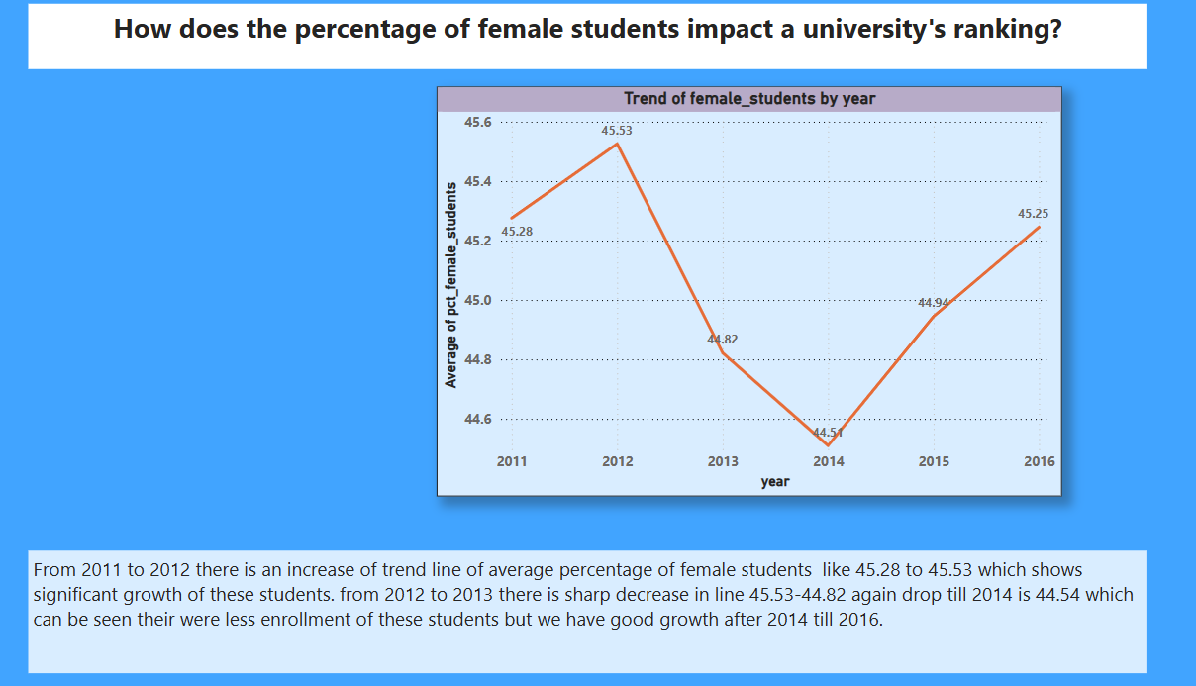

Slide 23
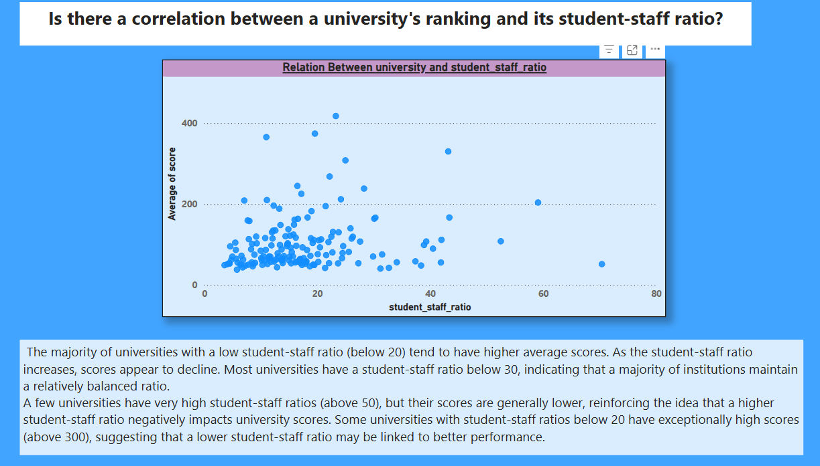

Slide 24
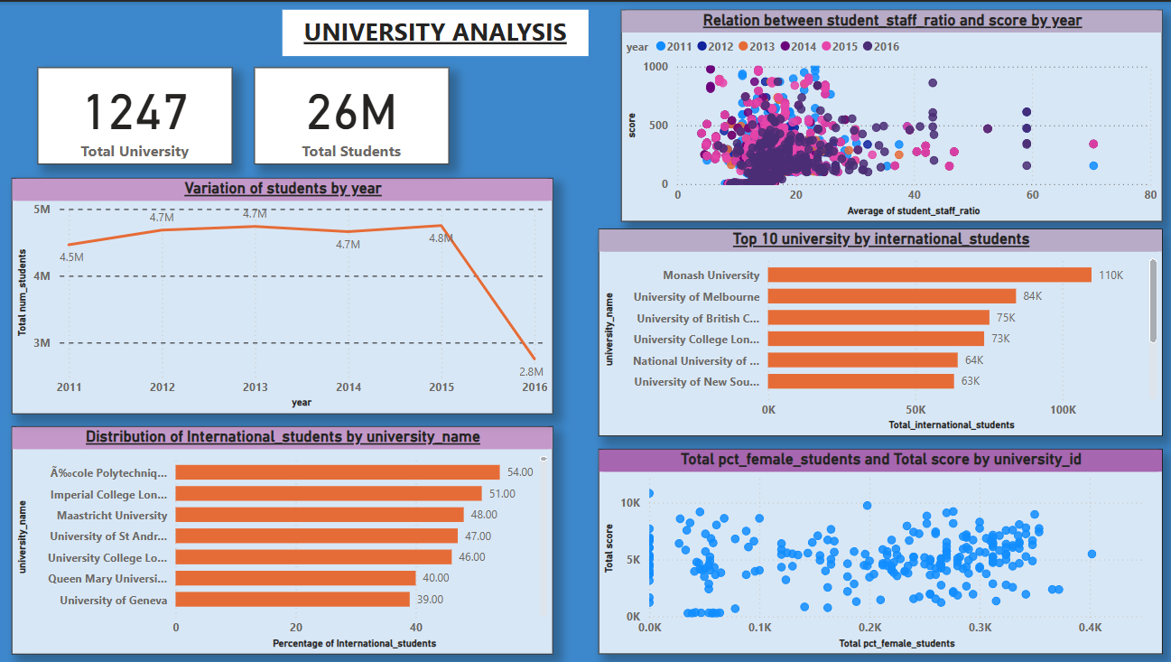

Slide 25
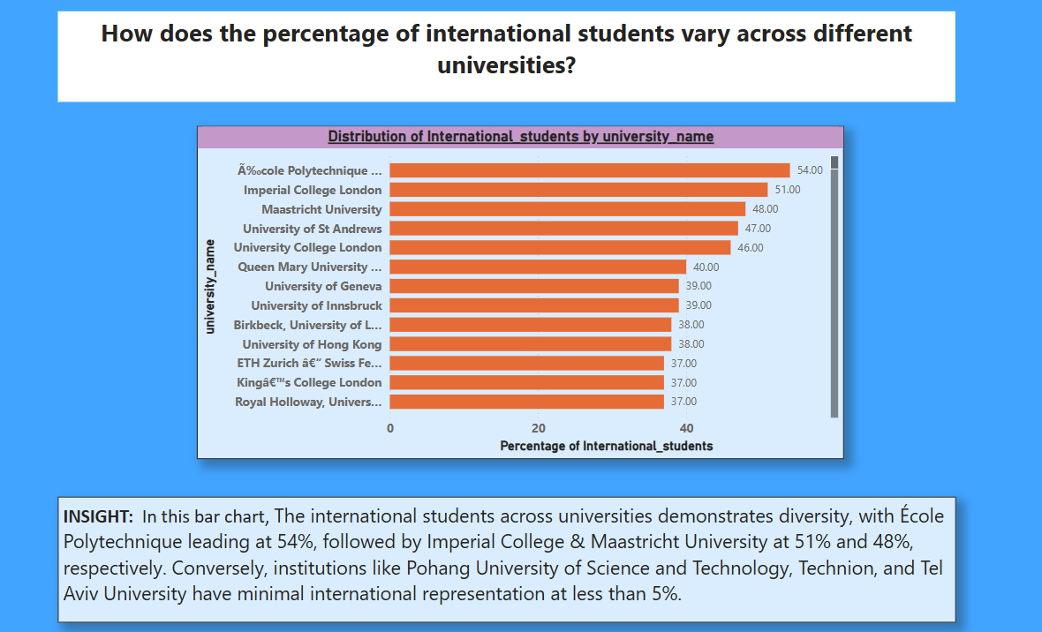

Slide 26
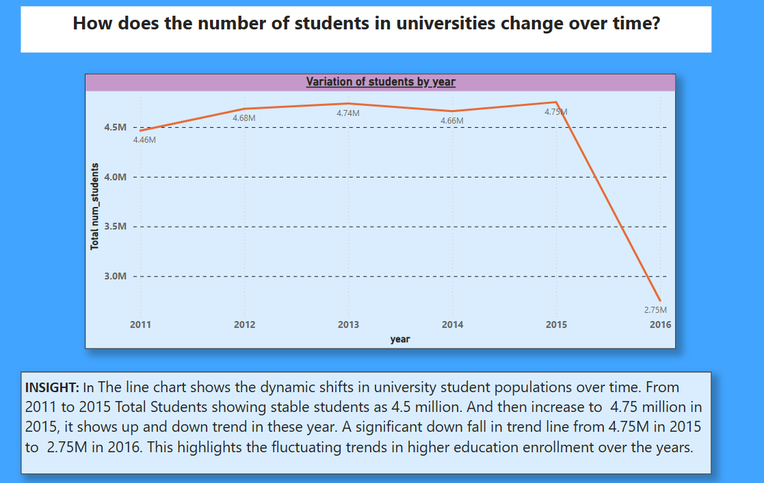

Slide 27
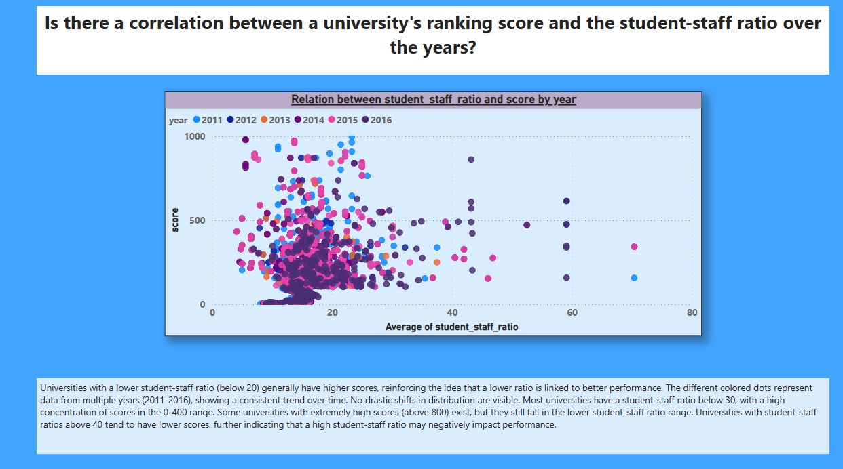

Slide 28
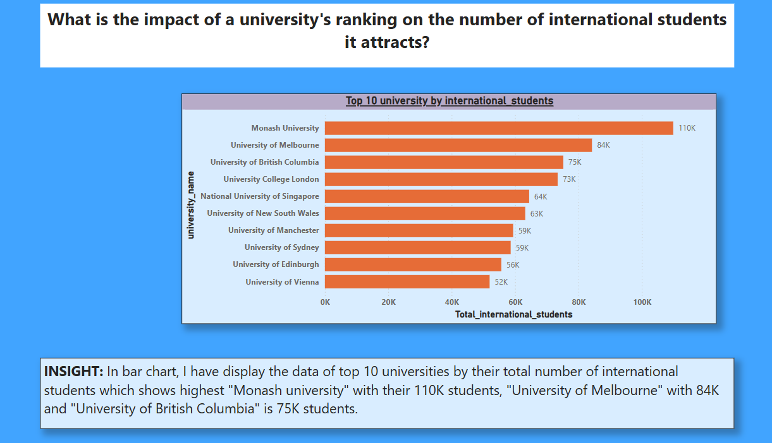

Slide 29
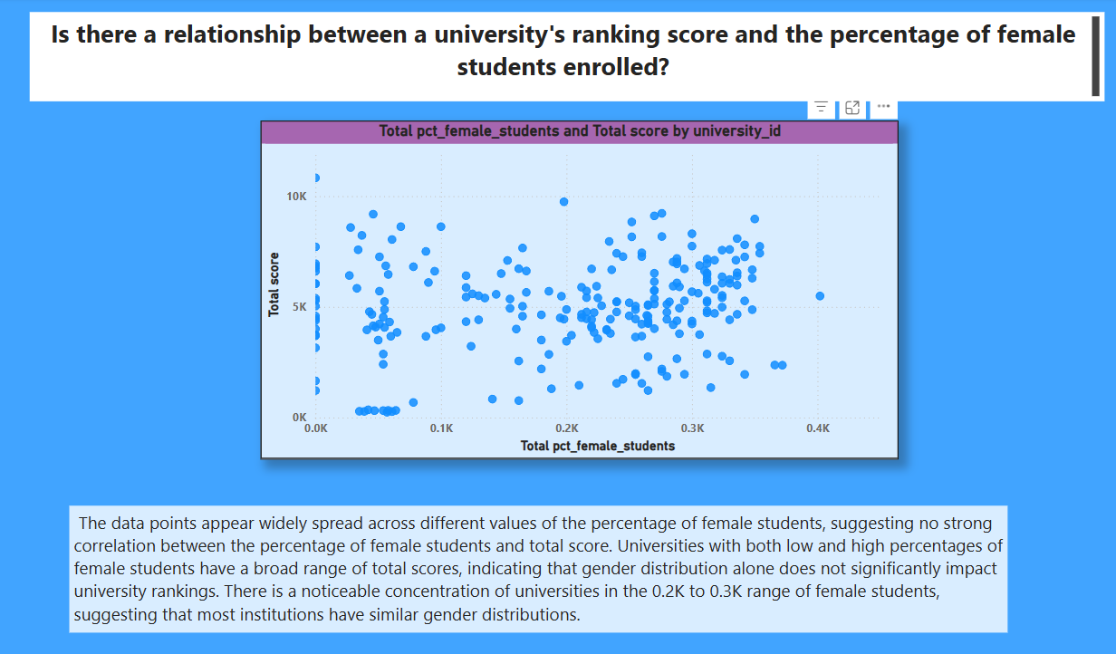

Slide 30
Eda problem statement

Slide 31
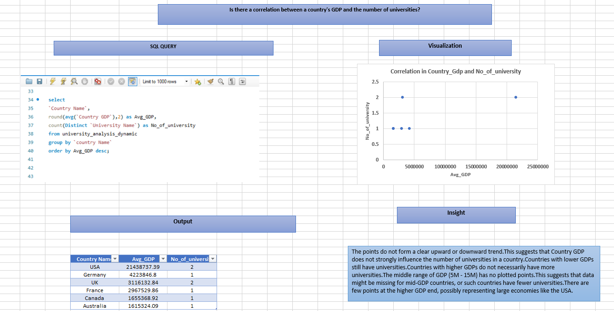

Slide 32
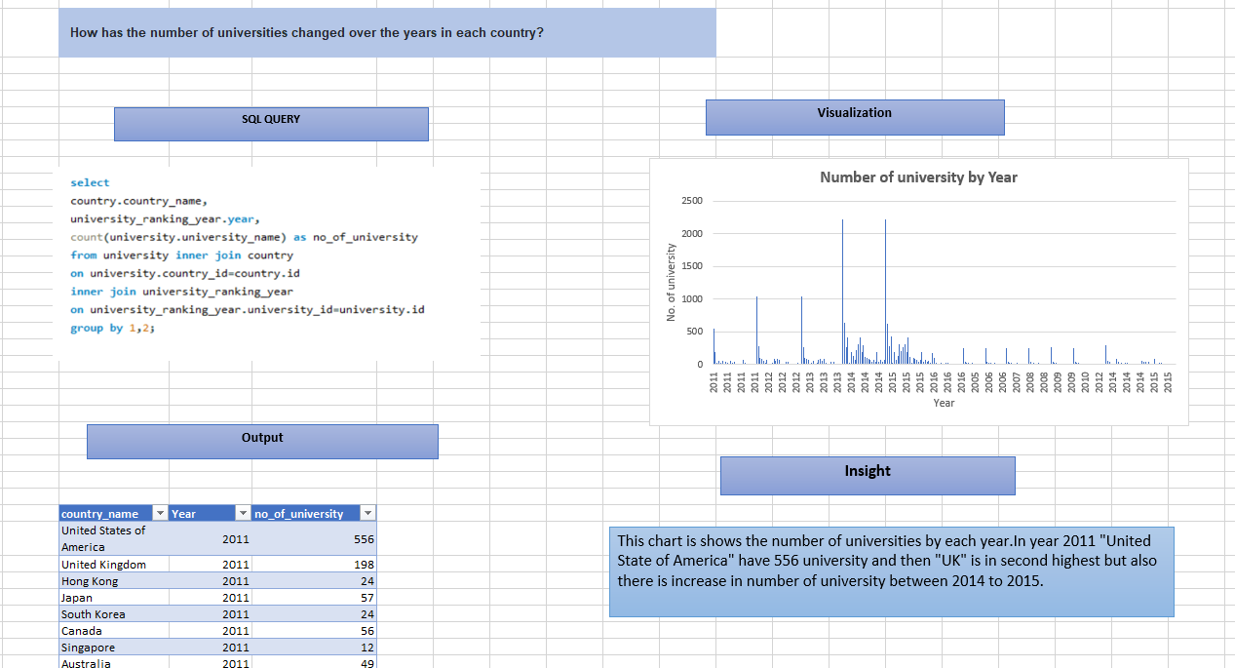

Slide 33
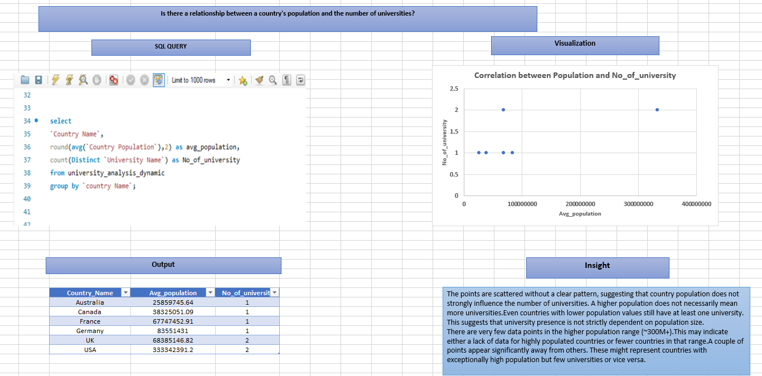

Slide 34
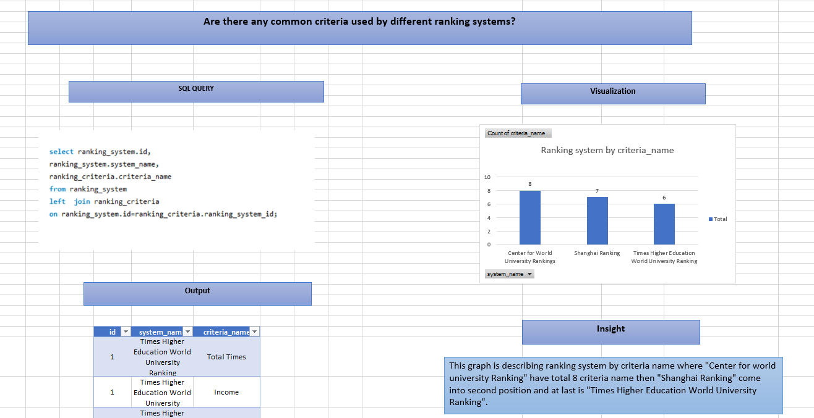

Slide 35
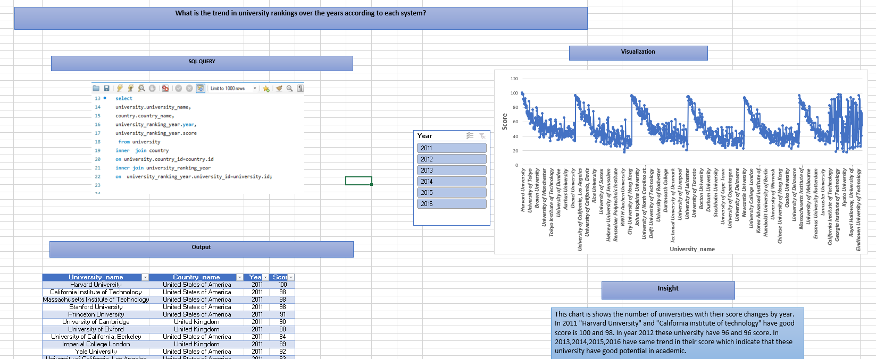

Slide 36
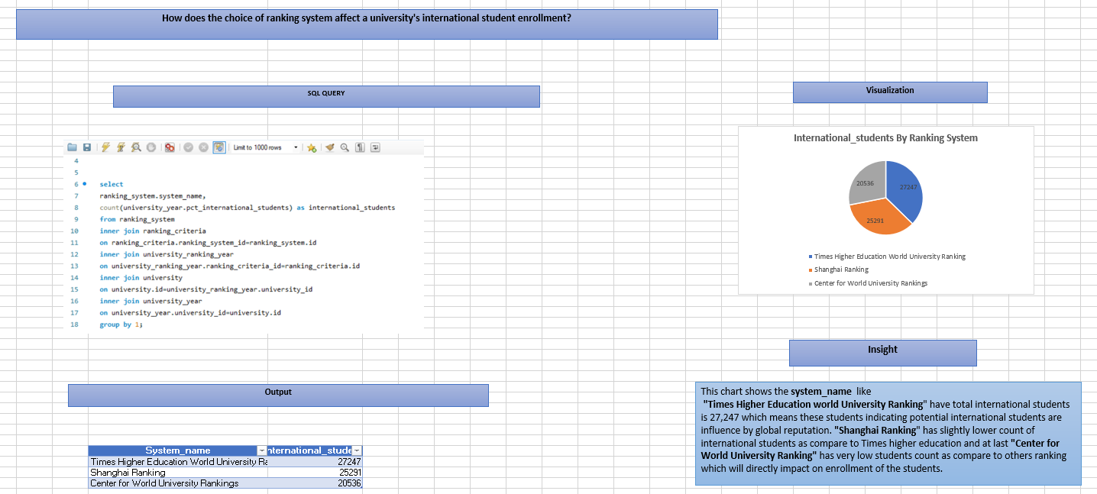

Slide 37
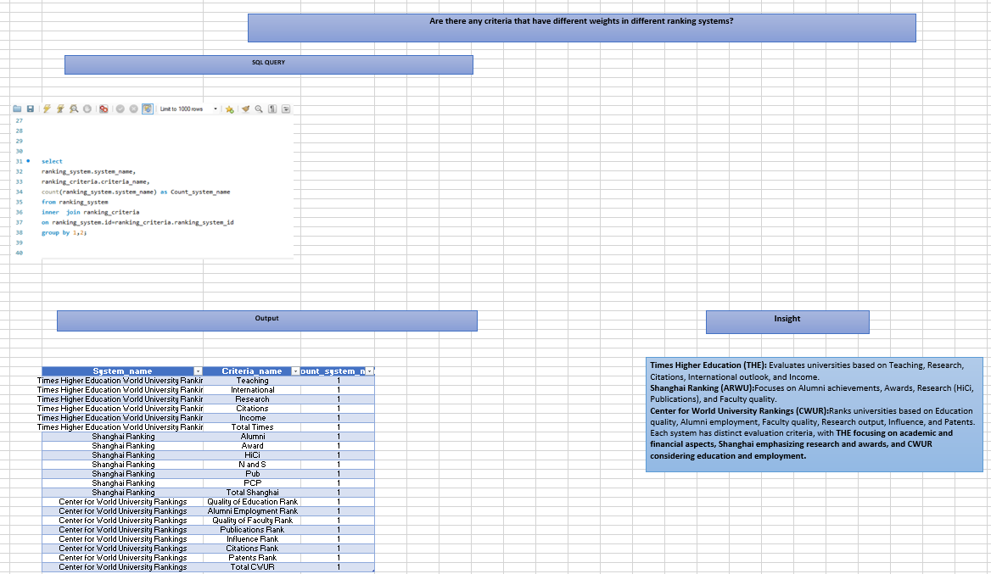

Slide 38
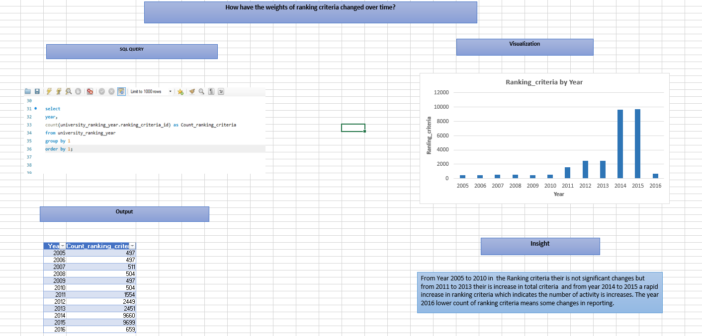

Slide 39
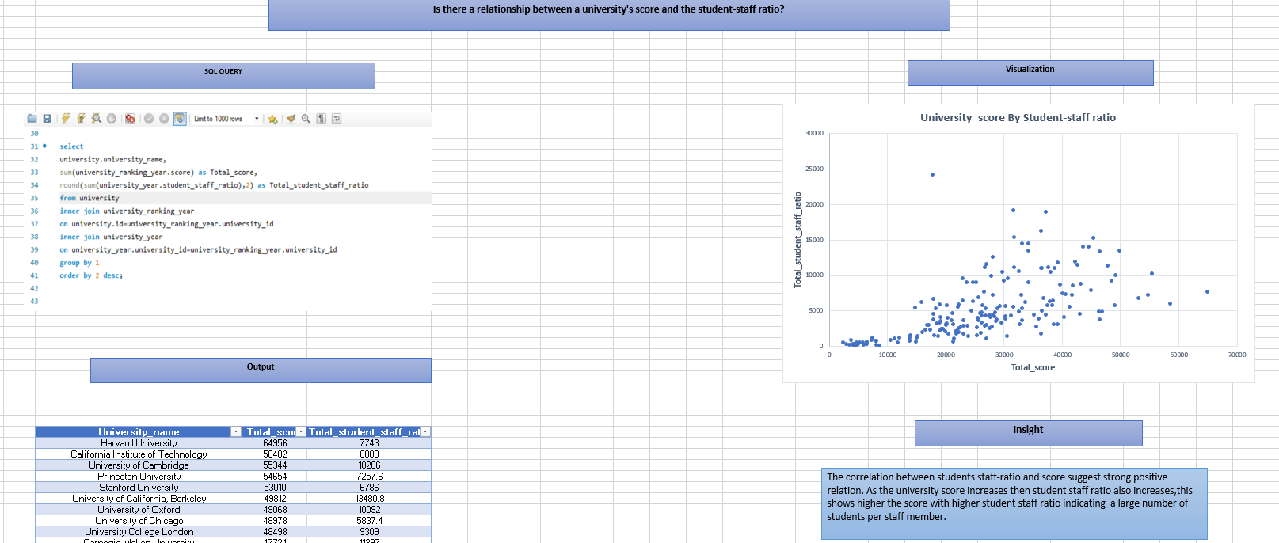

Slide 40
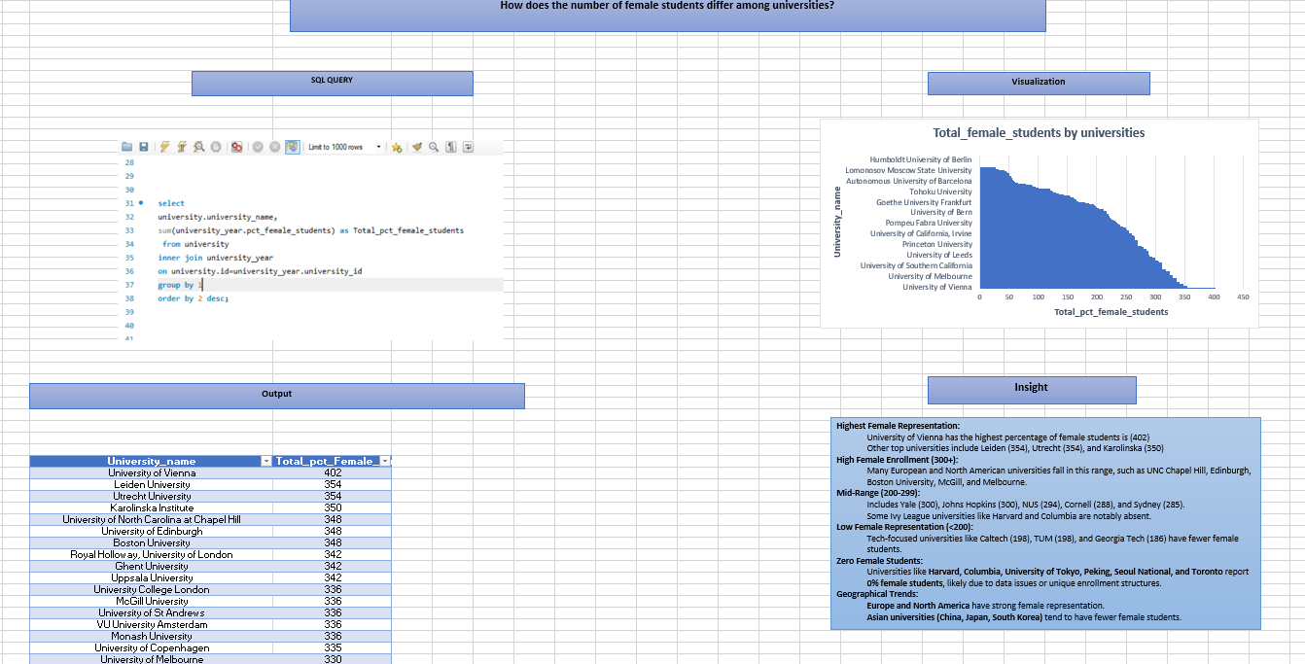

Slide 41
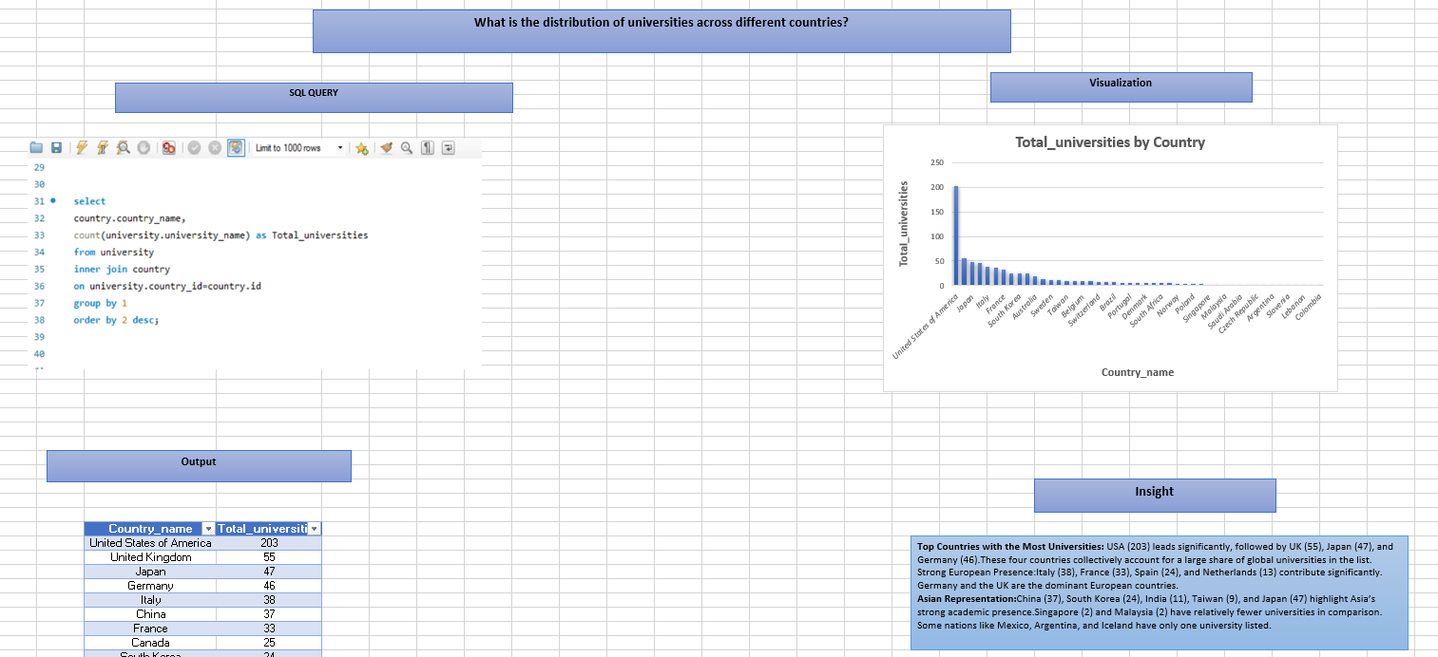

Slide 42
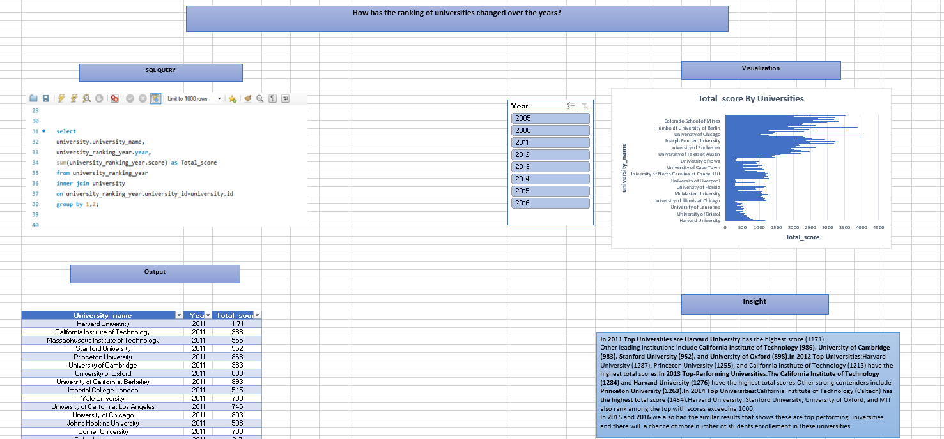

Slide 43
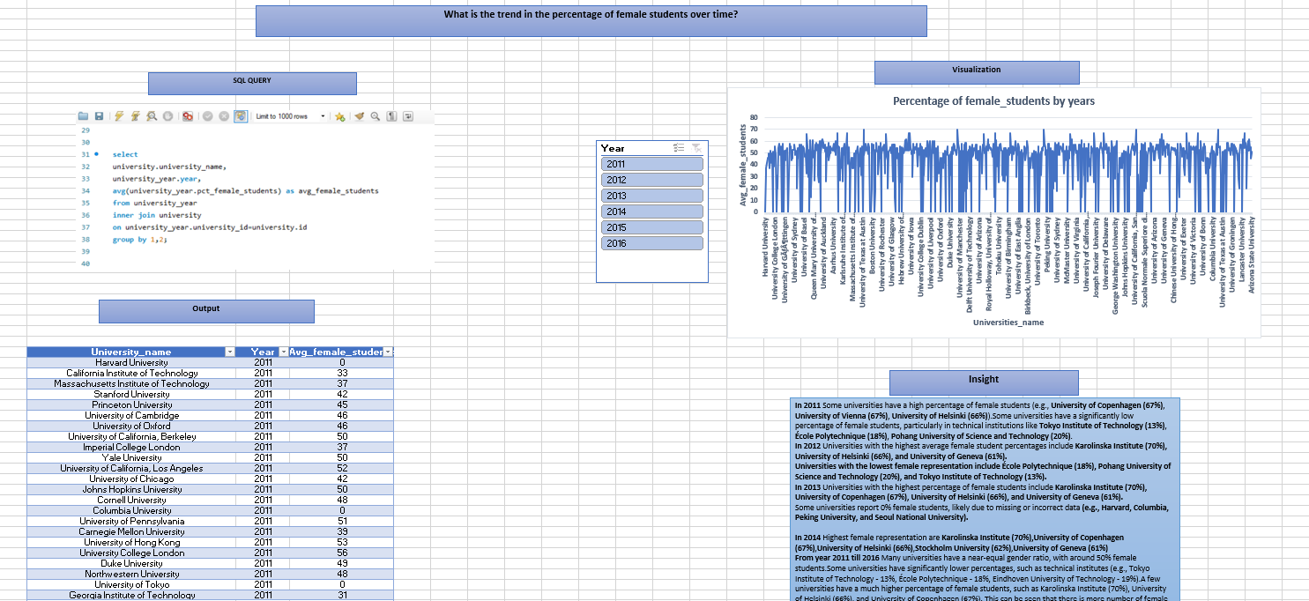

Slide 44
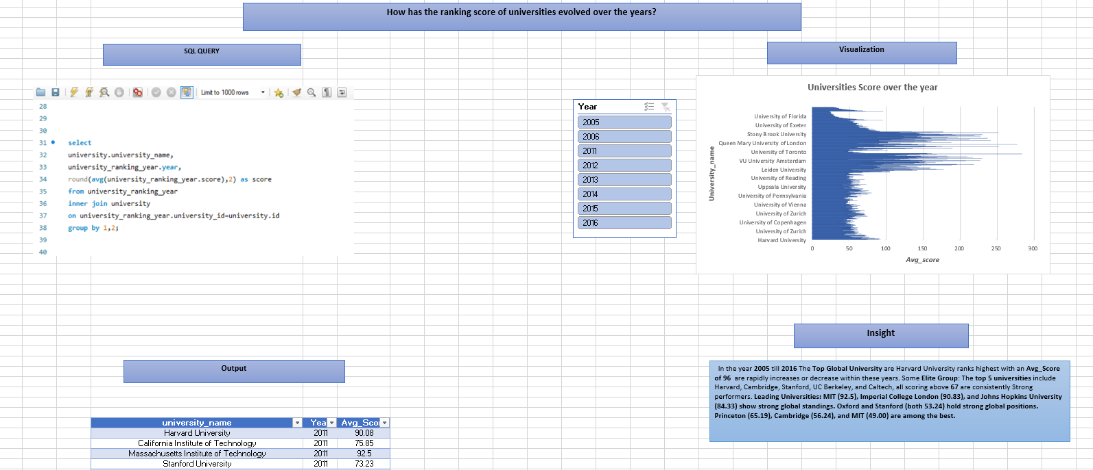

Slide 45
